Slide 1
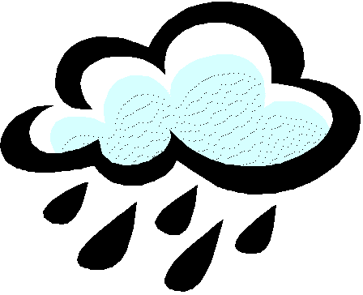
Virtualization and Cloud Computing
Norman Wilde
Thomas Huber
20090909_VirtualizationAndCloud
1

Slide 2
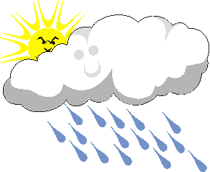
An opening caveat ...
This talk is based on speeches at conferences, discussions with people in industry, and some experimentation.
A lot of people think they will make a lot of money – so there is lots of hype!
But there seems to be something fundamental going on.
Some sun behind the clouds?
20090909_VirtualizationAndCloud

Slide 3
Two Technologies for Agility
Virtualization:
  The ability to run multiple operating systems on a single physical system and share the underlying hardware resources*
Cloud Computing:
  “The provisioning of services in a timely (near on instant), on-demand manner, to allow the scaling up and down of resources”**
* VMware white paper, Virtualization Overview
** Alan Williamson, quoted in Cloud BootCamp March 2009
20090909_VirtualizationAndCloud

Slide 4
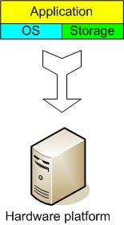
The Traditional Server Concept
Web Server
Windows
IIS
App Server
Linux
Glassfish
DB Server
Linux
MySQL
EMail
Windows
Exchange
20090909_VirtualizationAndCloud

Slide 5
And if something goes wrong ...
Web Server
Windows
IIS
App Server
DOWN!
DB Server
Linux
MySQL
EMail
Windows
Exchange
20090909_VirtualizationAndCloud

Slide 6
The Traditional Server Concept
System Administrators often talk about servers as a whole unit that includes the hardware, the OS, the storage, and the applications.
Servers are often referred to by their function i.e. the Exchange server, the SQL server, the File server, etc.
If the File server fills up, or the Exchange server becomes overtaxed, then the System Administrators must add in a new server.
20090909_VirtualizationAndCloud

Slide 7
The Traditional Server Concept
Unless there are multiple servers, if a service experiences a hardware failure, then the service is down.
System Admins can implement clusters of servers to make them more fault tolerant. However, even clusters have limits on their scalability, and not all applications work in a clustered environment.
20090909_VirtualizationAndCloud

Slide 8
The Traditional Server Concept
Pros
  Easy to conceptualize
  Fairly easy to deploy
  Easy to backup
  Virtually any application/service can be run from this type of setup
Cons
  Expensive to acquire and maintain hardware
  Not very scalable
  Difficult to replicate
  Redundancy is difficult to implement
  Vulnerable to hardware outages
  In many cases, processor is under-utilized
20090909_VirtualizationAndCloud

Slide 9
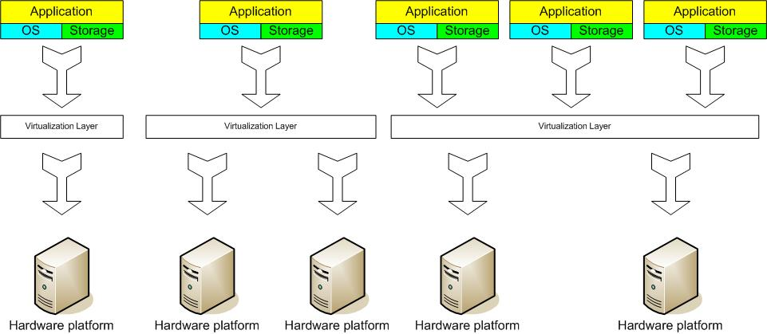
The Virtual Server Concept
Virtual Machine Monitor (VMM) layer between Guest OS and hardware
20090909_VirtualizationAndCloud

Slide 10
Close-up*
* adapted from a diagram in VMware white paper, Virtualization Overview
Server
1
Guest OS
Server
2
Guest OS
Clustering
Service Console
VMM (Virtual Machine Monitor)
x86 Architecture
Intercepts hardware requests
20090909_VirtualizationAndCloud

Slide 11
The Virtual Server Concept
Virtual servers seek to encapsulate the server software away from the hardware
  This includes the OS, the applications, and the storage for that server.
Servers end up as mere files stored on a physical box, or in enterprise storage.
A virtual server can be serviced by one or more hosts, and one host may house more than one virtual server.
20090909_VirtualizationAndCloud

Slide 12
The Virtual Server Concept
Virtual servers can still be referred to by their function i.e. email server, database server, etc.
If the environment is built correctly, virtual servers will not be affected by the loss of a host.
Hosts may be removed and introduced almost at will to accommodate maintenance.
20090909_VirtualizationAndCloud

Slide 13
The Virtual Server Concept
Virtual servers can be scaled out easily.
  If the administrators find that the resources supporting a virtual server are being taxed too much, they can adjust the amount of resources allocated to that virtual server
Server templates can be created in a virtual environment to be used to create multiple, identical virtual servers
Virtual servers themselves can be migrated from host to host almost at will.
20090909_VirtualizationAndCloud

Slide 14
The Virtual Server Concept
Pros
  Resource pooling
  Highly redundant
  Highly available
  Rapidly deploy new servers
  Easy to deploy
  Reconfigurable while services are running
  Optimizes physical resources by doing more with less
Cons
  Slightly harder to conceptualize
  Slightly more costly (must buy hardware, OS, Apps, and now the abstraction layer)
20090909_VirtualizationAndCloud

Slide 15
Virtualization Status
Offerings from many companies
  e.g. VMware, Microsoft, Sun, ...
Hardware support
  Fits well with the move to 64 bit (very large memories) multi-core (concurrency) processors.
  Intel VT (Virtualization Technology) provides hardware to support the Virtual Machine Monitor layer
Virtualization is now a well-established technology
20090909_VirtualizationAndCloud

Slide 16

So what about
Cloud Computing?
20090909_VirtualizationAndCloud

Slide 17
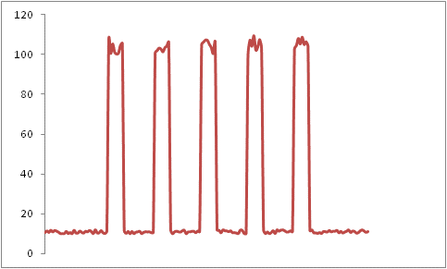
Suppose you are Forbes.com
You offer on-line real time stock market data
Why pay for capacity weekends, overnight?
9 AM - 5 PM,
M-F
Rate of Server Accesses
ALL OTHER
TIMES
20090909_VirtualizationAndCloud

Slide 18
Forbes' Solution
Host the web site in Amazon's EC2 Elastic Compute Cloud
Provision new servers every day, and deprovision them every night
Pay just $0.10* per server per hour
  * more for higher capacity servers
Let Amazon worry about the hardware!
20090909_VirtualizationAndCloud

Slide 19
Cloud computing takes virtualization to the next step
You don’t have to own the hardware
You “rent” it as needed from a cloud
There are public clouds
  e.g. Amazon EC2, and now many others (Microsoft, IBM, Sun, and others ...)
A company can create a private one
  With more control over security, etc.
20090909_VirtualizationAndCloud

Slide 20
Goal 1 – Cost Control
Cost
  Many systems have variable demands
    Batch processing (e.g. New York Times)
    Web sites with peaks (e.g. Forbes)
    Startups with unknown demand (e.g. the Cash for Clunkers program)
  Reduce risk
    Don't need to buy hardware until you need it
20090909_VirtualizationAndCloud

Slide 21
Goal 2 - Business Agility
More than scalability - elasticity!
  Ely Lilly in rapidly changing health care business
    Used to take 3 - 4 months to give a department a server cluster, then they would hoard it!
  Using EC2, about 5 minutes!
    And they give it back when they are done!
Scaling back is as important as scaling up
20090909_VirtualizationAndCloud

Slide 22
Goal 3 - Stick to Our Business
Most companies don't WANT to do system administration
  Forbes says:
    We are is a publishing company, not a software company
But beware:
  Do you really save much on sys admin?
  You don't have the hardware, but you still need to manage the OS!
20090909_VirtualizationAndCloud

Slide 23
How Cloud Computing Works
Various providers let you create virtual servers
  Set up an account, perhaps just with a credit card
You create virtual servers ("virtualization")
  Choose the OS and software each "instance" will have
  It will run on a large server farm located somewhere
  You can instantiate more on a few minutes' notice
  You can shut down instances in a minute or so
They send you a bill for what you use
20090909_VirtualizationAndCloud

Slide 24
Any Nasty Details?
(loads of them!)
How do I pick a provider?
Am I locked in to a provider?
Where do I put my data?
What happens to my data when I shut down?
How do I log in to my server?
How do I keep others from logging in (security)?
How do I get an IP address?
Etc.
20090909_VirtualizationAndCloud

Slide 25
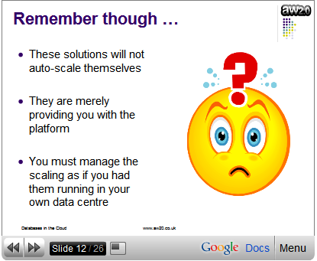
And One Really Important Caveat*
* Cloud BootCamp March 2009
20090909_VirtualizationAndCloud

Slide 26
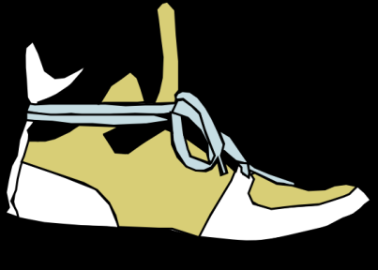
(footnote)
How come Amazon?
Grew out of efforts to manage Amazon’s own services
  (Each time you get a page from Amazon, over a hundred servers are involved)
  See reference Amazon Architecture on their service design concepts
They got so good at it that they launched Amazon Web Services (AWS) as a product
20090909_VirtualizationAndCloud

Slide 27
Cloud Computing Status
Seems to be rapidly becoming a mainstream practice
Numerous providers
  Amazon EC2 imitators ...
  Just about every major industry name
    IBM, Sun, Microsoft, ...
Major buzz at industry meetings
20090909_VirtualizationAndCloud

Slide 28
So What’s the Take-Away?
There seems to be a major revolution underway in how we manage hardware
  Specify (machine per service or one big machine with many virtual servers
  Purchase (own it yourself or rent from a public cloud)
  Use (always-on, or flexible provisioning as needed ...)
We may need to rethink both our research and teaching
and software?
20090909_VirtualizationAndCloud

Slide 29
For UWF:
What About Research?
The Eucalyptus Project
  From University of California Santa Barbara
  An open source collection of tools to build your own cloud
    Linux using Xen for virtualization
An apparently open research area: handling data
  Regular databases apparently don't scale well
  Especially hard to make elastic (scale up / scale down)
20090909_VirtualizationAndCloud

Slide 30
For UWF:
What About Teaching?
Our graduates should know about cloud computing / virtualization
  It will be useful for some applications, though not for all
But what are the right learning objectives?
  Awareness (its there ...)
  Mechanics (here’s how to instantiate a server ...)
  Design (how to make a scalable service ...)
  ???
20090909_VirtualizationAndCloud

Slide 31
For Fall 2009 ...
Currently developing a Virtualization / Cloud Computing “module”
  1 – 2 class sessions plus an exercise
Target courses (November):
  COP 6990 – Multi-Process Computing (Simmons)
  CTS 4817 – Web Server Administration (Owsnicki-Klewe)
Objectives
  Awareness and mechanics of EC2
20090909_VirtualizationAndCloud

Slide 32
References
(links are current as of September, 2009)
VMware Inc., Virtualization Overview, http://www.vmware.com/pdf/virtualization.pdf
Todd Hoff, Amazon Architecture, http://highscalability.com/amazon-architecture, Sept. 18, 2007
Intel Corp., Technology brief: Understanding Intel® Virtualization Technology, http://download.intel.com/technology/virtualization/320426.pdf
aw2.0 Ltd, Cloud BootCamp March 2009, http://www.aw20.co.uk/help/cloudbootcamp_march2009.cfm
20090909_VirtualizationAndCloud

Slide 33
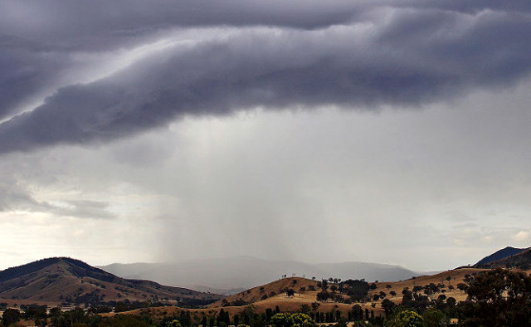
Where do we go from here?
Any ideas to keep us out of the rain?
20090909_VirtualizationAndCloud

